Slide 1

aq

Slide 2
Goals of this talk
Explore some of the JavaScript engines which are available
Allow you to make a more informed choice of which to use
Skip some of the leg work for options that aren’t relevant to your use case

Slide 3
About Me
10+ years of JUCE and C++
A bit of everything in the audio space
From build systems to distribution and everything in between

Slide 4
Why I looked at these engines
Building a UI framework allowing off the shelf
JS frameworks to be used with a JUCE based UI

Slide 5
SCREENSHOT OF AIR REVERB

Slide 6
Video OF AIR REVERB
Change text colour
Add a component from the JUCE demo

Slide 7
This talk ISN’T…
UI - HTML/CSS
Web Views
Prescriptive

Slide 8
Why you might be looking at these engines
End user scripting
Tools for creating content for your products
Experimenting without requiring a rebuild

Slide 9
Why JavaScript specifically
Popular

Slide 10
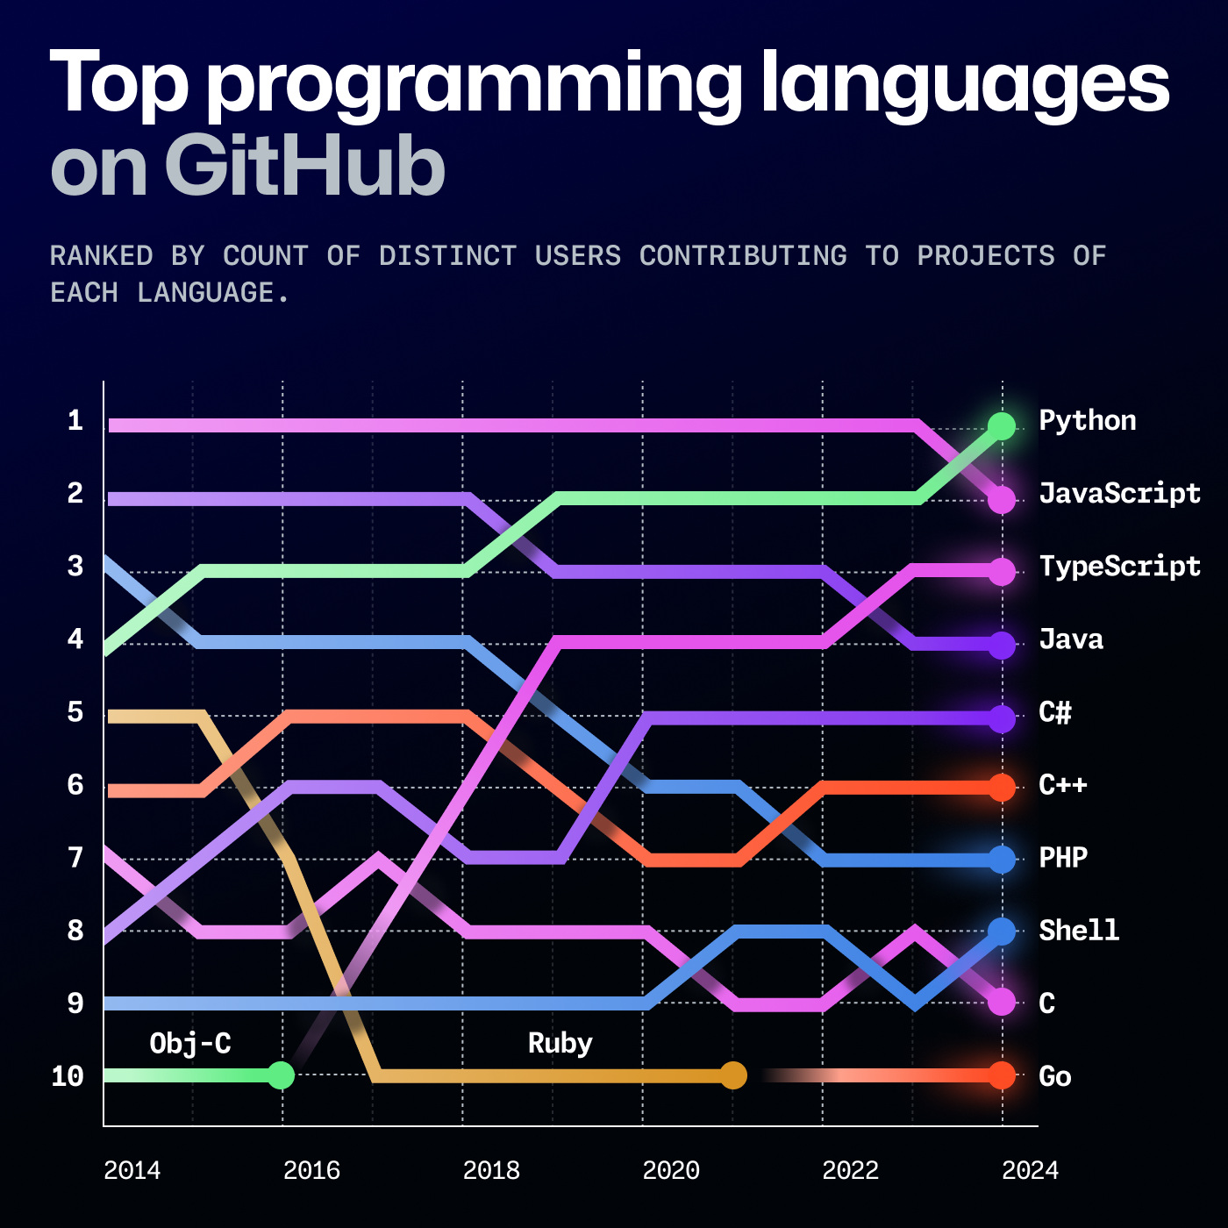
Why JavaScript specifically

Slide 11
Why JavaScript specifically
Lots of resources online
Potentially the most familiar to customers
NPM Packages

Slide 12
Why JavaScript specifically
Lots of resources online
Potentially the most familiar to customers
NPM Packages
Very familiar syntax
Lots of engine options of differing sizes

Slide 13
What we’ll be focusing on…
Characteristics of each engine
C++ Interop
Building with CMake
Desktop Cross Platform concerns and gotchas

Slide 14
Supporting Repo
https://github.com/andyjtb/js-engine-emporium

Slide 15
Factors to Consider
Binary Size
Startup time
Test262 Conformance
Ease of integration (both build and code)

Slide 16
ECMA Conformance
https://compat-table.github.io/compat-table/es6/

Slide 17
The Big Hitters

Slide 18
V8
JavaScriptCore
Made for Chrome
Very Fast - JIT-ed
Fairly large
Builds with GN - But CMake projects exist
Fairly Debuggable
Made for WebKit (Safari)
Very Fast - JIT-ed
Fairly large
Builds with CMake - Clang on Windows for JIT
Debuggable in Safari on Mac, hard on Windows

Slide 19
Small and embeddable

Slide 20
Duktape
QuickJS
Very small
All C - DukGlue exists
Somewhat old – All ECMA 5.1 (2011), some 6 and 7
Somewhat slow
Very small
All C – Lots of C++ wrappers
Quick for interpreted - Not JIT but Bytecode
Debuggable with modifications
Available in JUCE 8 onwards

Slide 21
Escargot
JerryScript
Made by Samsung
Memory constrained platforms
C++
Potentially some crossover with Escargot
All in C
Code doesn’t look all that similar
ECMAScript 5.1

Slide 22
The Experimental

Slide 23
Hermes
Porffor
Made by Facebook for React Native
Static Hermes
Made in JS
AOT compiler for WASM and C

Slide 24
I think I’ve made some decisions Any other information you want to throw at me?

Slide 25
Suggestions
Use a wrapper for C++
Notes:
Stuff to remember with a wrapper Super useful for memory management Syntax Function/class exposing
Allows the engine to be switch out and decisions on engine to be pushed down the road until you’re more sure about the use case

Slide 26
Wrappers

Slide 27
Wrappers
ScriptX – JavascriptCore, V8
JSI - JSI V8
Choc JS Engines
Notes:
Maybe make this a table?

Slide 28
Suggestions
Use a wrapper for C++
Notes:
Like JUCE, provides the lowest common denominator of functionality
Prime example being JavascriptCore’s API which is very limited, string JS code only, maybe having to take a code of that string
Leads on to next suggestion

Slide 29
Suggestions
Use a wrapper for C++
Precompile is code known before
Notes:
If engine supports bytecode and code known before, this can dramatically speed up the running of the code
Brief explanation of bytecode
Not parsing the JS every time to get the same result

Slide 30
Suggestions
Use a wrapper for C++
Precompile is code known before
Check build options
Notes:
Lot of options in terms of reducing binary size Hermes/V8 both provide build without compiler

Slide 31
Thanks
https://github.com/andyjtb/js-engine-emporium

